Slide 1
Blockchain Technology
1st Application
Cryptocurrency Bitcoin
Dr. Kunwar Singh
CSE Department
NIT Trichy

Slide 2

Bitcoin Cryptocurrency
Bitcoin
No trusted party. Decentralized ledgers on Internet. It is peer to peer network: Distribute and record transactions.
Very Low Transaction fees Not Reversible
All transactions are known to everyone.
Users can only see the transactions. Actual senders and receivers cannot be identified.

Slide 3
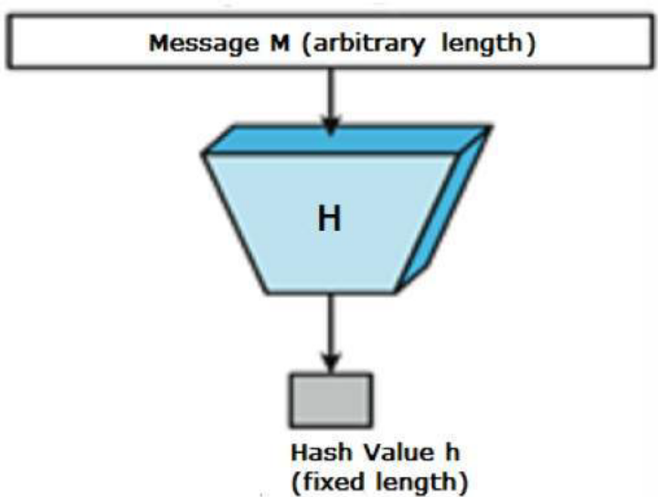
Cryptographic Hash Functions
It takes 10^27 years to calculate 2^128 hashes
Properties
Pre-image Resistant: Given h, hard to find m such that h = hash(m).
Second Pre-image Resistant: Given m1, hard to find m2 such that hash(m1) = hash(m2)
Collision Resistant: Hard to find m1 and m2 such that
hash(m1) = hash(m2).

Slide 4
Symmetric Cryptosystem
Caeser Cryptosystem:

Slide 5
Public-Key Cryptography by Diffi & Helleman
No need to share the secret key before communication (Unlike symmetric cryptosystem),
Every user has two keys:
Public key: is made public
Private key: is private to the user
One can encrypt (lock) with both keys but decrypt (open) can be done by the key which is different from encryption key.
Can be used in shared session key set up.
Dept. of CSE, NITT

Slide 6

Public Key Encryption
From Staulling
Dept. of CSE, NITT
4

Slide 7
Public-key encryption
A public-key encryption scheme consists of three algorithms:
  Gen: randomized algorithm that on input 1^{n} outputs pk, sk
  Enc: randomized algorithm that on input pk and a message m outputs a ciphertext c.
  Dec: determinstic algorithm that on input sk and a ciphertext c outputs a message m or an error ⊥
  Correctness: Dec_{sk}(Enc_{pk}(m)) = m

Slide 8
ELLIPTIC CURVE CRYPTOSYSTEMS
Although RSA and ElGamal are secure asymmetric-key cryptosystems, their security comes with a price, their large keys.
ECC provide same level of security with smaller key sizes.
Elliptic Curves over GF( p)
10.<number>
From Behroun Forouzan and Debdeep Mukhopadhyay

Slide 9
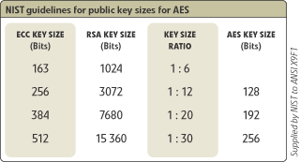
ECC as Light – weight Encryption
Notes:
1024 bits approx = 300 digits

Slide 10
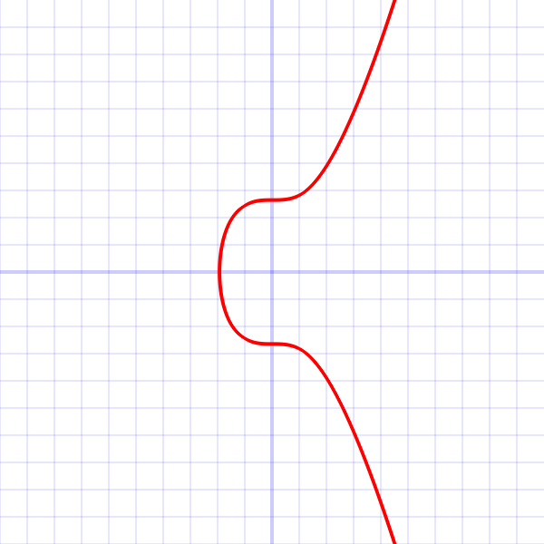
ECDSA in Bitcoin
secp256k1 curve (Bitcoin) parameters
G = (x, y) is the generator of cyclic subgroup of elliptic group
Where X = 79BE667E F9DCBBAC 55A06295 CE870B07
029BFCDB 2DCE28D9 59F2815B 16F81798
Y = 483ADA77 26A3C465 5DA4FBFC 0E1108A8
FD17B448 A6855419 9C47D08F FB10D4B8
secp256k1's elliptic curve
order(G) = q is a prime,
where q = FFFFFFFF FFFFFFFF FFFFFFFF
FFFFFFFF BAAEDCE6 AF48A03B
BFD25E8C D0364141

Slide 11


Signature
Alice
Everyone else
Alice’s
Unique
Hand writing
Message
M
Message
M
Alice’s previous signature
Signature
Signature
Signature
Verify
function
Signature is independent of the message
Indeed
signed by Alice

Slide 12
Digital Signatures
Alice
Everyone else
Message
M
Alice’s Private Key
Message
M
Alice’s Public Key
Sign
function
Signature
for M
Verify
function
Signature
for M
Message M was indeed
signed by Alice

Slide 13
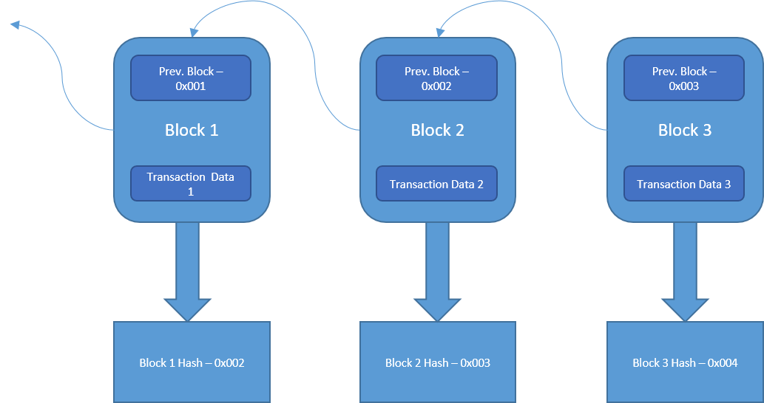
Blockchain
Genesis Block
Hash pointer : Hash and address of previous block

Slide 14
Hypothetical Cryptocurrencies (Goofy Coin)
double-spending attack
signed by pk_{Alice}
signed by pk_{Alice}
Pay to pk_{Bob} : H( )
Pay to pk_{Chuck} : H( )
signed by pk_{Goofy}
signed by pk_{Goofy}
Pay to pk_{Alice} : H( )
Pay to pk_{Alice} : H( )
signed by pk_{Goofy}
signed by pk_{Goofy}
CreateCoin [uniqueCoinID]
CreateCoin [uniqueCoinID]

Slide 15

Centralised Goofy Coin
Genesis Block
prev: H( )
prev: H( )
prev: H( )
transID: 71
transID: 72
transID: 73
trans
trans
trans
Transaction Hash
INPUT
5BTC
OUTPUT
Bob’s
Address
Locktime
Signed with Alice

Slide 16
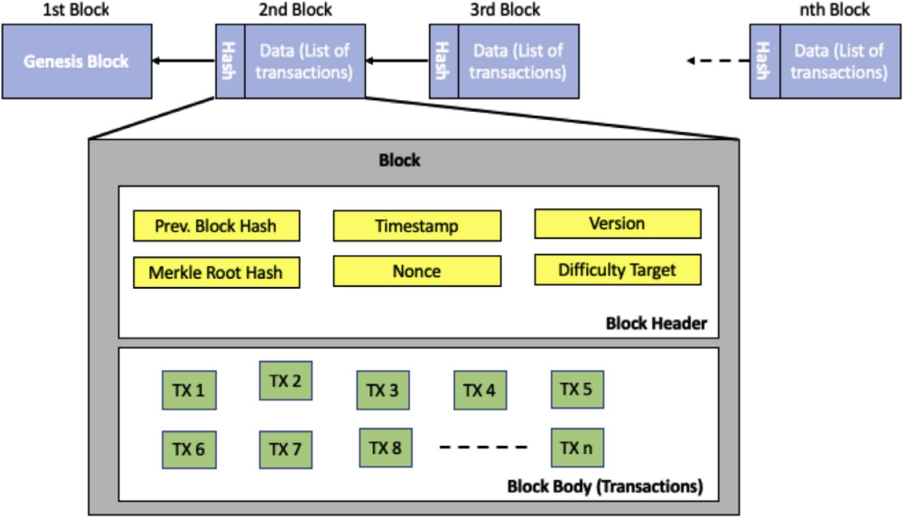
Source: Andreas Kamilaris Agusti Fontsa, Francesc X. Prenafeta-Boldύa The rise of blockchain technology in agriculture and food supply chains

Slide 17
Block
Header
Block Format
Block size: 1 MB until August 2017 and 4 MB after that.
The nVersion: contains the current block version number.
Double SHA-256 of previous block header
nTime: Time of candidate block creation
nBits: 256-bit unsigned integer called the target threshold
Coinbase transaction has no input. It contains miner’s reward for the mining effort.
Block header (80 byes)
Number of Transactions n
Coinbase Transaction
Regular Transaction 1
Regular Transaction 2
...
Regular Transaction n
nVersion
hashPrevBlock
hashMerkleRoot
nTime
nBits
nNonce
Block header (80 byes)
Number of Transactions n
Coinbase Transaction
Regular Transaction 1
Regular Transaction 2
...
Regular Transaction n

Slide 18
Merkle Hash Treehttp://www.cs.cmu.edu › class3-advanced-security
Verifier knows T₀
How can verifier authenticate leaf D₂ ?
Solution: recompute T₀ using D₂
Example authenticate D₂ , send D₃ T₃ T₂
Verify T₀ = H( H( T₃ || H( D₂ || D₃ )) || T₂ )
T₂
T₃
D₃
T₀
T₁
T₂
T₃
T₄
T₅
T₆
D₀
D₁
D₂
D₃
D₄
D₅
D₆
D₇

Slide 19
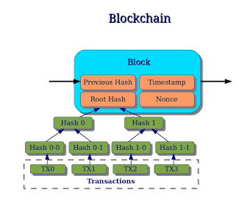


Slide 20
Hash puzzles:
To create block, find nonce s.t.
H(nonce ‖ prev_hash ‖ tx ‖ … ‖ tx) is very small
SHA 256

Slide 21
Hash puzzles:
To create block, find nonce s.t.
H(nonce ‖ prev_hash ‖ tx ‖ … ‖ tx) is very small
SHA 256
nonce
prev_h
Tx
Tx
Output space of hash
Target
space
The target originally started out at:
00000000ffff0000000000000000000000000000000000000000000000000000
The current target is:
0000000000000000001f0d9b0000000000000000000000000000000000000000

Slide 22
Hash puzzles:
Decentralized Goofy Coin (Bitcoin)
Consensus Algorithm (Proof of Work):
1. New transactions are broadcast to all nodes.
2. Special nodes(miner) track transactions and add them to “candidate block”. Due to transaction ordering issues, candidate blocks in each miner may be different.
3. Special node which solves hash puzzle will be able to add new block into Blockchain. This node (called miner) will be rewarded 6.25 BTC(1bitcoin = 53,751$).
To create block, find nonce s.t.
H(nonce ‖ prev_hash ‖ tx ‖ … ‖ tx) is very small
nonce
Output space of hash
prev_h
Tx
Tx
4. Other nodes accept the block only if all transactions in it are valid (unspent, valid signatures)
5. Nodes express their acceptance of the block by working on creating the next block

Slide 23
Blockchain approach to choose a node
Consensus Algorithm (Proof of Work):
Random selection
Incentive to add to longest chain
Penalties to those adding to their chain
Notes:
Penalies : spending the electricity to solve the problem

Slide 24
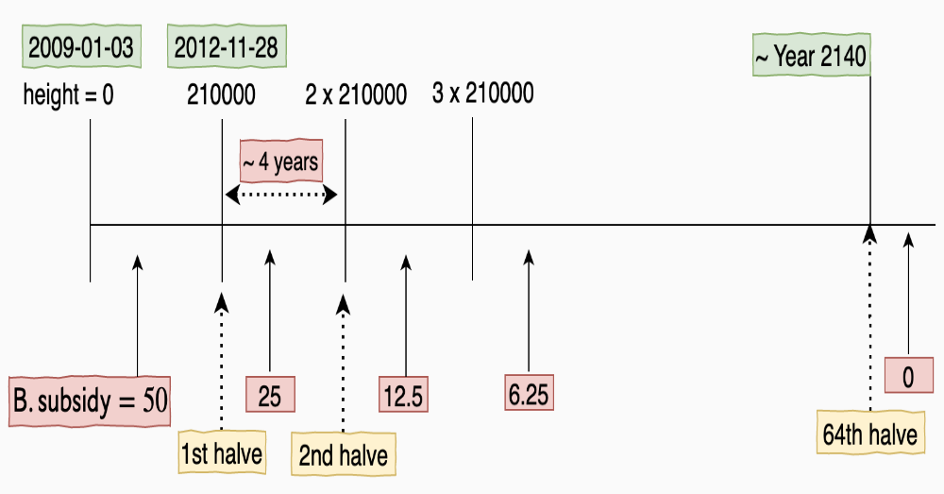
Reward Money
Block subsidy for solving the puzzle was 50 BTC. It becomes half after 210000 blocks (around 4 years).
Total reward money = Block subsidy + transaction fee

Slide 25
In April 2013 the Economist have explained that bitcoin is certainly is one of the things which are going to shape the future of finance and payment and famously compared bitcoin to digital gold.
Virtual currencies: Mining digital gold, From the print edition: Finance and economics, The Economist, 13 April 2013.

Slide 26
Disadvantage: requires huge amounts of energy. 54 TWe per year. Which is electricity requirement of New Zealand or Hungary.
Proof of Stake (PoS)
Attributing mining power to the proportion of coins held by a miner.
Suppose Alice has 20% of the total coins and Bob has 15% of the total coins. Alice will be given 20% of total nodes and so Bob.
One node is randomly chosen as minor.
assumption that a majority of the wealth in the system is controlled by honest participants.
The rationale behind PoS is that users who have significant stakes in the system have an economic incentive in keeping the system running according to the protocol specification, as they risk that their stakes will become worthless if trust in the cryptocurrency vanishes.

Slide 27
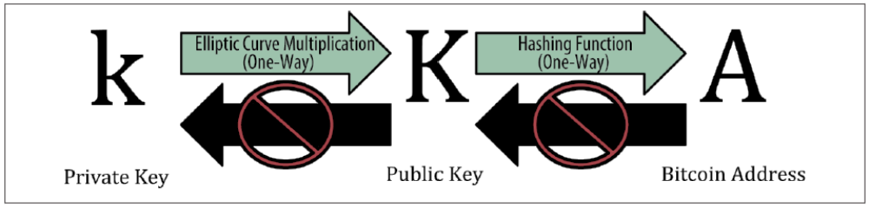
Bitcoin Wallet
Uses Public Key Cryptography
To spend Bitcoin assigned to the address owner has to produce Signature corresponding to the address.
Pair of private key and addresses

Slide 28
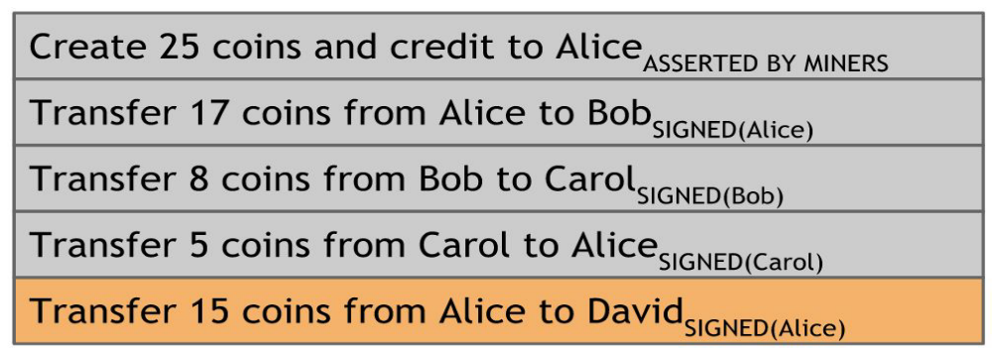
An account-based ledger
Disadvantage: to check the validity of transaction one has to keep track of these account balances
Source: Book by Arvind Narayanan et al on Bitcoin and Cryptocurrency Technologies

Slide 29
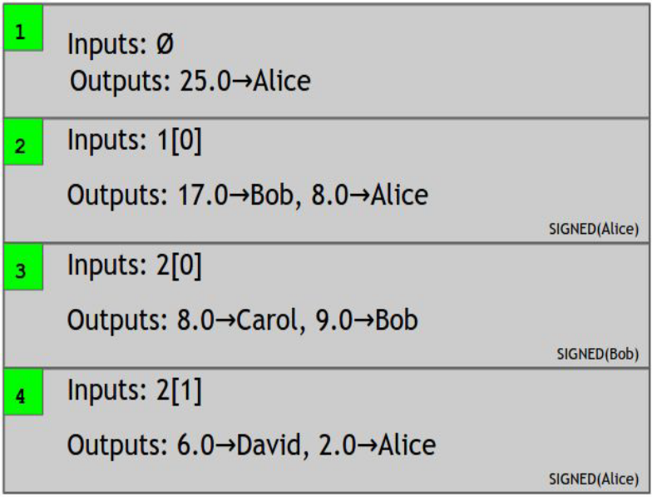
Bitcoin Transaction
Transaction-based ledger, which is very close to Bitcoin
In Bitcoin, the entirety of a transaction output must be consumed by another transaction, or none of it.
Source: Book by Arvind Narayanan etc al on Bitcoin and Cryptocurrency Technologies

Slide 30
Coins are divisible and transactions are multi-input and multi-output.

Slide 31
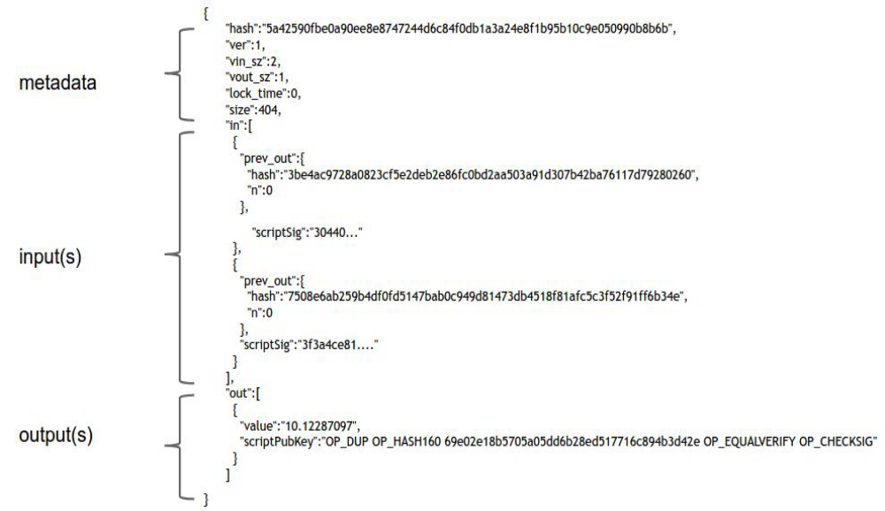
Bitcoin Script
An actual Bitcoin transaction
Bitcoin scripting language: stack-based, programming language and similar to Forth
Notes:
Each transaction output doesn’t just specify a public key. It actually specifies a script. The scripting language was built specifically for Bitcoin, and is just called
‘Script’ or the Bitcoin scripting language. It has many similarities to a language called Forth, which is an old, simple, stack-based, programming language

Slide 32
Challenge script
OP_DUP OP_HASH160 <PubKeyHash> OP_EQUALVERIFY OP_CHECKSIG
Response script:
<Signature> <Public Key>

Slide 33
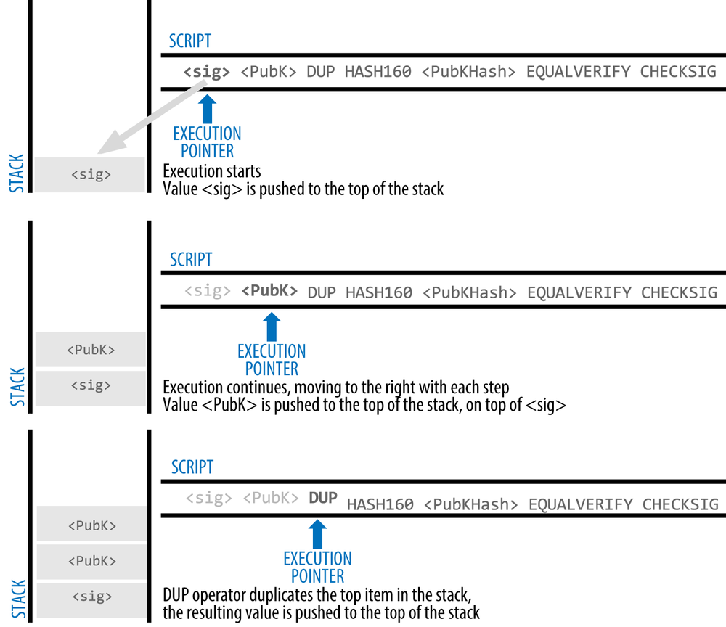
Source: https://www.oreilly.com/library/view/mastering-bitcoin/9781491902639/ch05.html

Slide 34
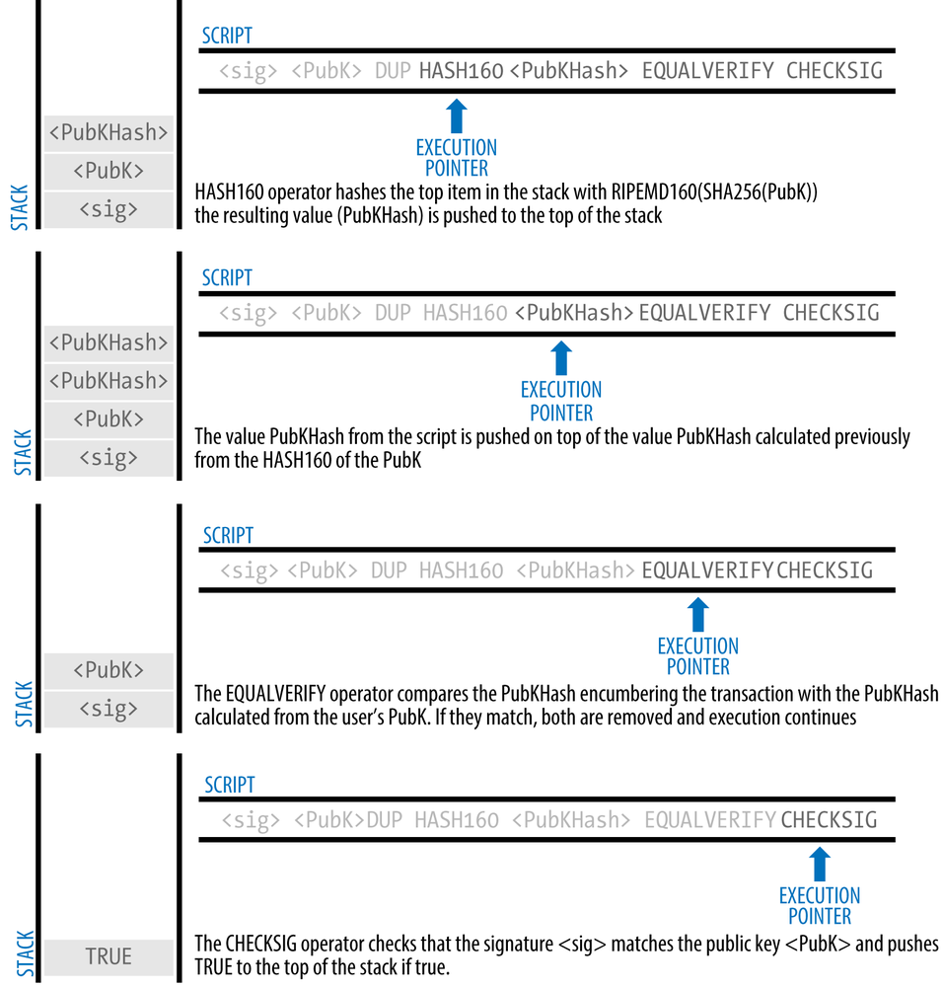

Slide 35
MultiSignature (m out of n)
Challenge script:
M <Public Key 1> <Public Key 2> ... <Public Key N> N OP_CHECKMULTISIG
For example 2-of-3 multi-signature
Challenge script:
2 <Public Key 1> <Public Key 2> <Public Key 3> 3 OP_CHECKMULTISIG
Response script:
OP_0 <Signature 2> <Signature 3>

Slide 36
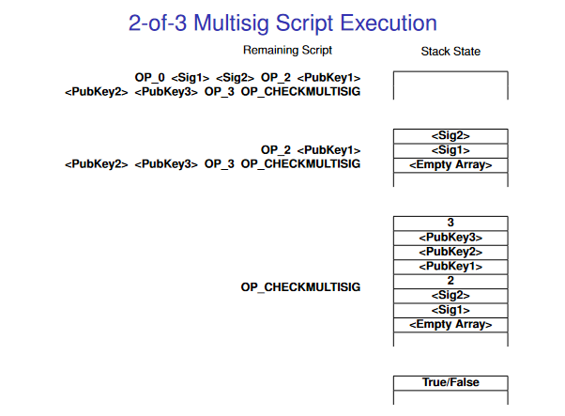

Slide 37
Forking
fork happens when two or more miners find a block at nearly the same time.
Solution Block A N+1 |  | Block N + 2
· · ·
Block
N − 2
Block
N − 1
Block
N
Solution Block B
N+1
Both miners will broadcast their solution on the network
Nodes will accept the first solution they hear and reject others
B
B
A
^{M}B
A
B
A ^{M}A
B
B
A
A
A
B B
Nodes always switch to the longest chain they hear
The network abandons the blocks that are not in the longest chain (they are called orphaned blocks).
Notes:
If two blocks are mined at block height N, there is a fork. As soon as a single N+1 is mined and broadcasted, any nodes that receive it will keep the block N that it builds upon, and orphan the other block as there is now one chain with more work.

Slide 38
Accidental bifurcation is therefore rare, and occurs on average once about every 60 blocks
Decker, C., Wattenhofer, R.: Information propagation in the bitcoin network. In: IEEE P2P. (2013)

Slide 39
Total Bitcoin
The rate at which the new Bitcoins are generated is designed to slowly decrease towards zero, and will reach zero when almost 21 million Bitcoins are created.
Then, the miners’ revenue will be only from transaction fees

Slide 40
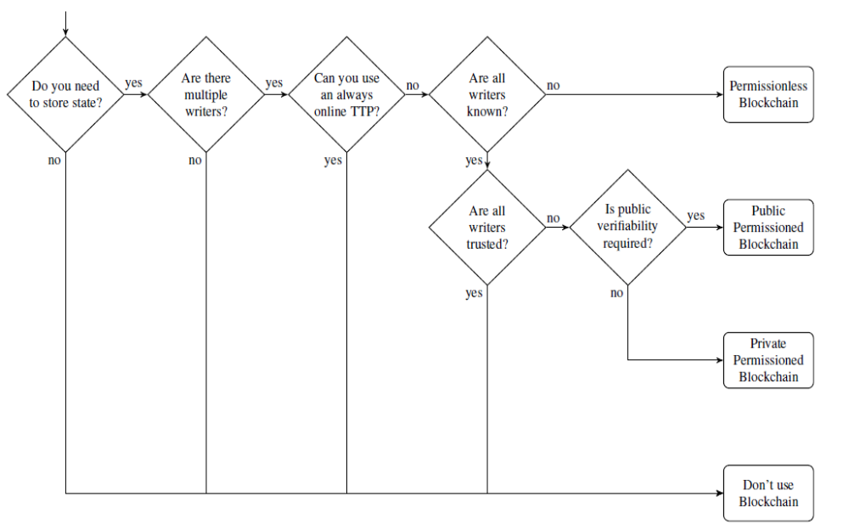
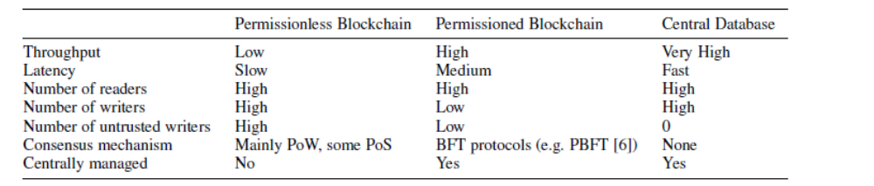
Blockchain: When to use

Slide 41
References
Book by Arvind Narayanan, Joseph Bonneau, Edward Felten, Andrew Miller, Steven Goldfeder
Bitcoin and Cryptocurrency Technologies
An Introduction to Bitcoin, S. Vijayakumaran,www.ee.iitb.ac.in/~sarva/bitcoin.html

Slide 42
THANK YOU

